Slide 1

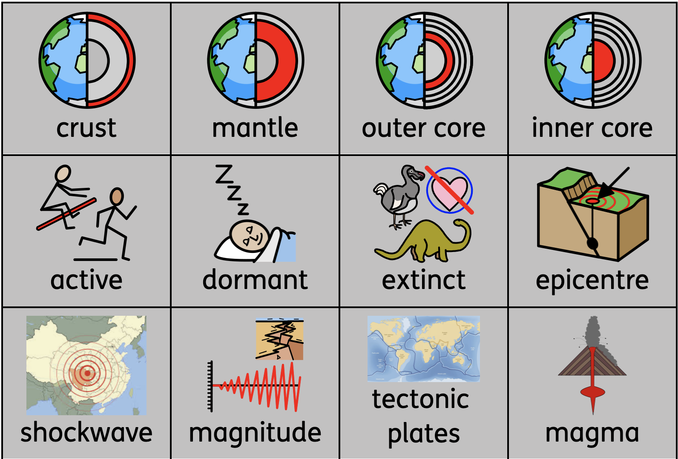
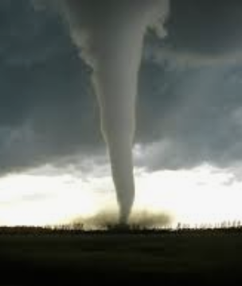
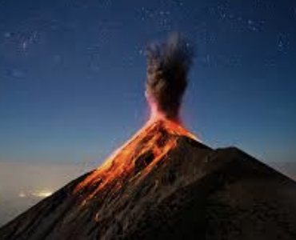
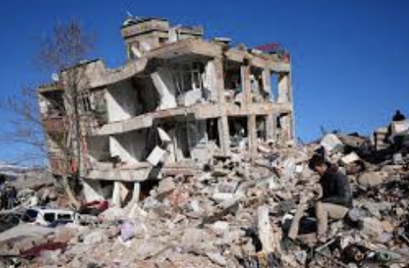
Knowledge Organiser
Geography – Term 4
Volcanoes, Earthquakes & Tornados
What I should already know
that there are volcanoes
What I will learn
I will:
know what is underground
know how volcanoes are formed
know the effects of a volcanic eruption
know why earthquakes happen
know the impact of earthquakes to human life
know what causes tornados
Key vocabulary

