Slide 1




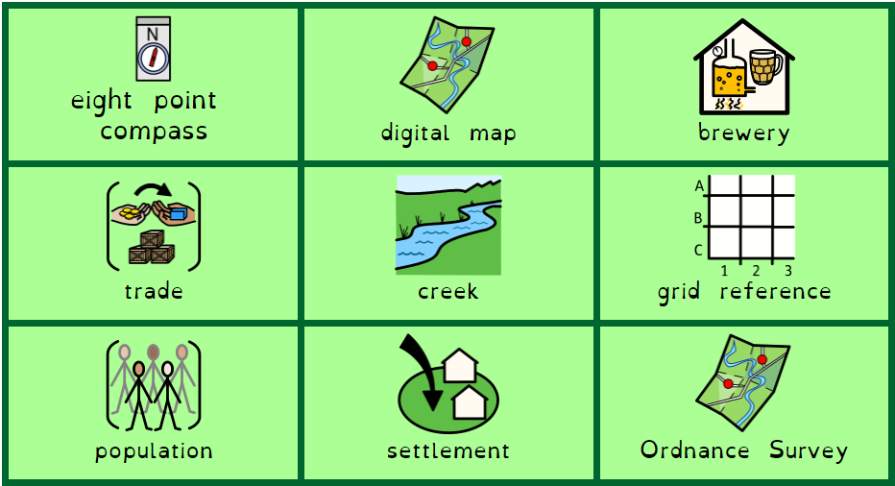
Beer and Barges
Faversham Focus (Creek and Industry)
Geography – Year 4 – Term 6
What should I already know?
Nile.ng to learn? (Sticky t am I going to learn? (Sticky am I going to learn? (w
What should I already know?
To use four point compass, four-figure grid references and symbols to investigate an area
To collect data and present it in an appropriate way
To sketch maps of the local area
To consider the impact of geographical features on population
What am I going to learn? (Sticky knowledge)
To know features of our local area
To know why a location is chosen as a settlement
To use the eight points of a compass, four and six-figure grid references, symbols and key to investigate the local area
To observe and collect information about features of the local area
To compare different types of maps of the local area
To construct own maps using different media
To know the impact of local features on the local population
Vocabulary

