Slide 1

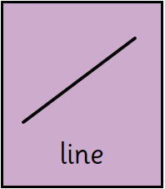
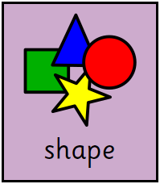
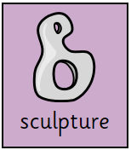
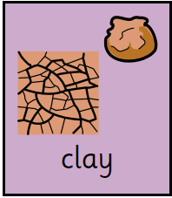
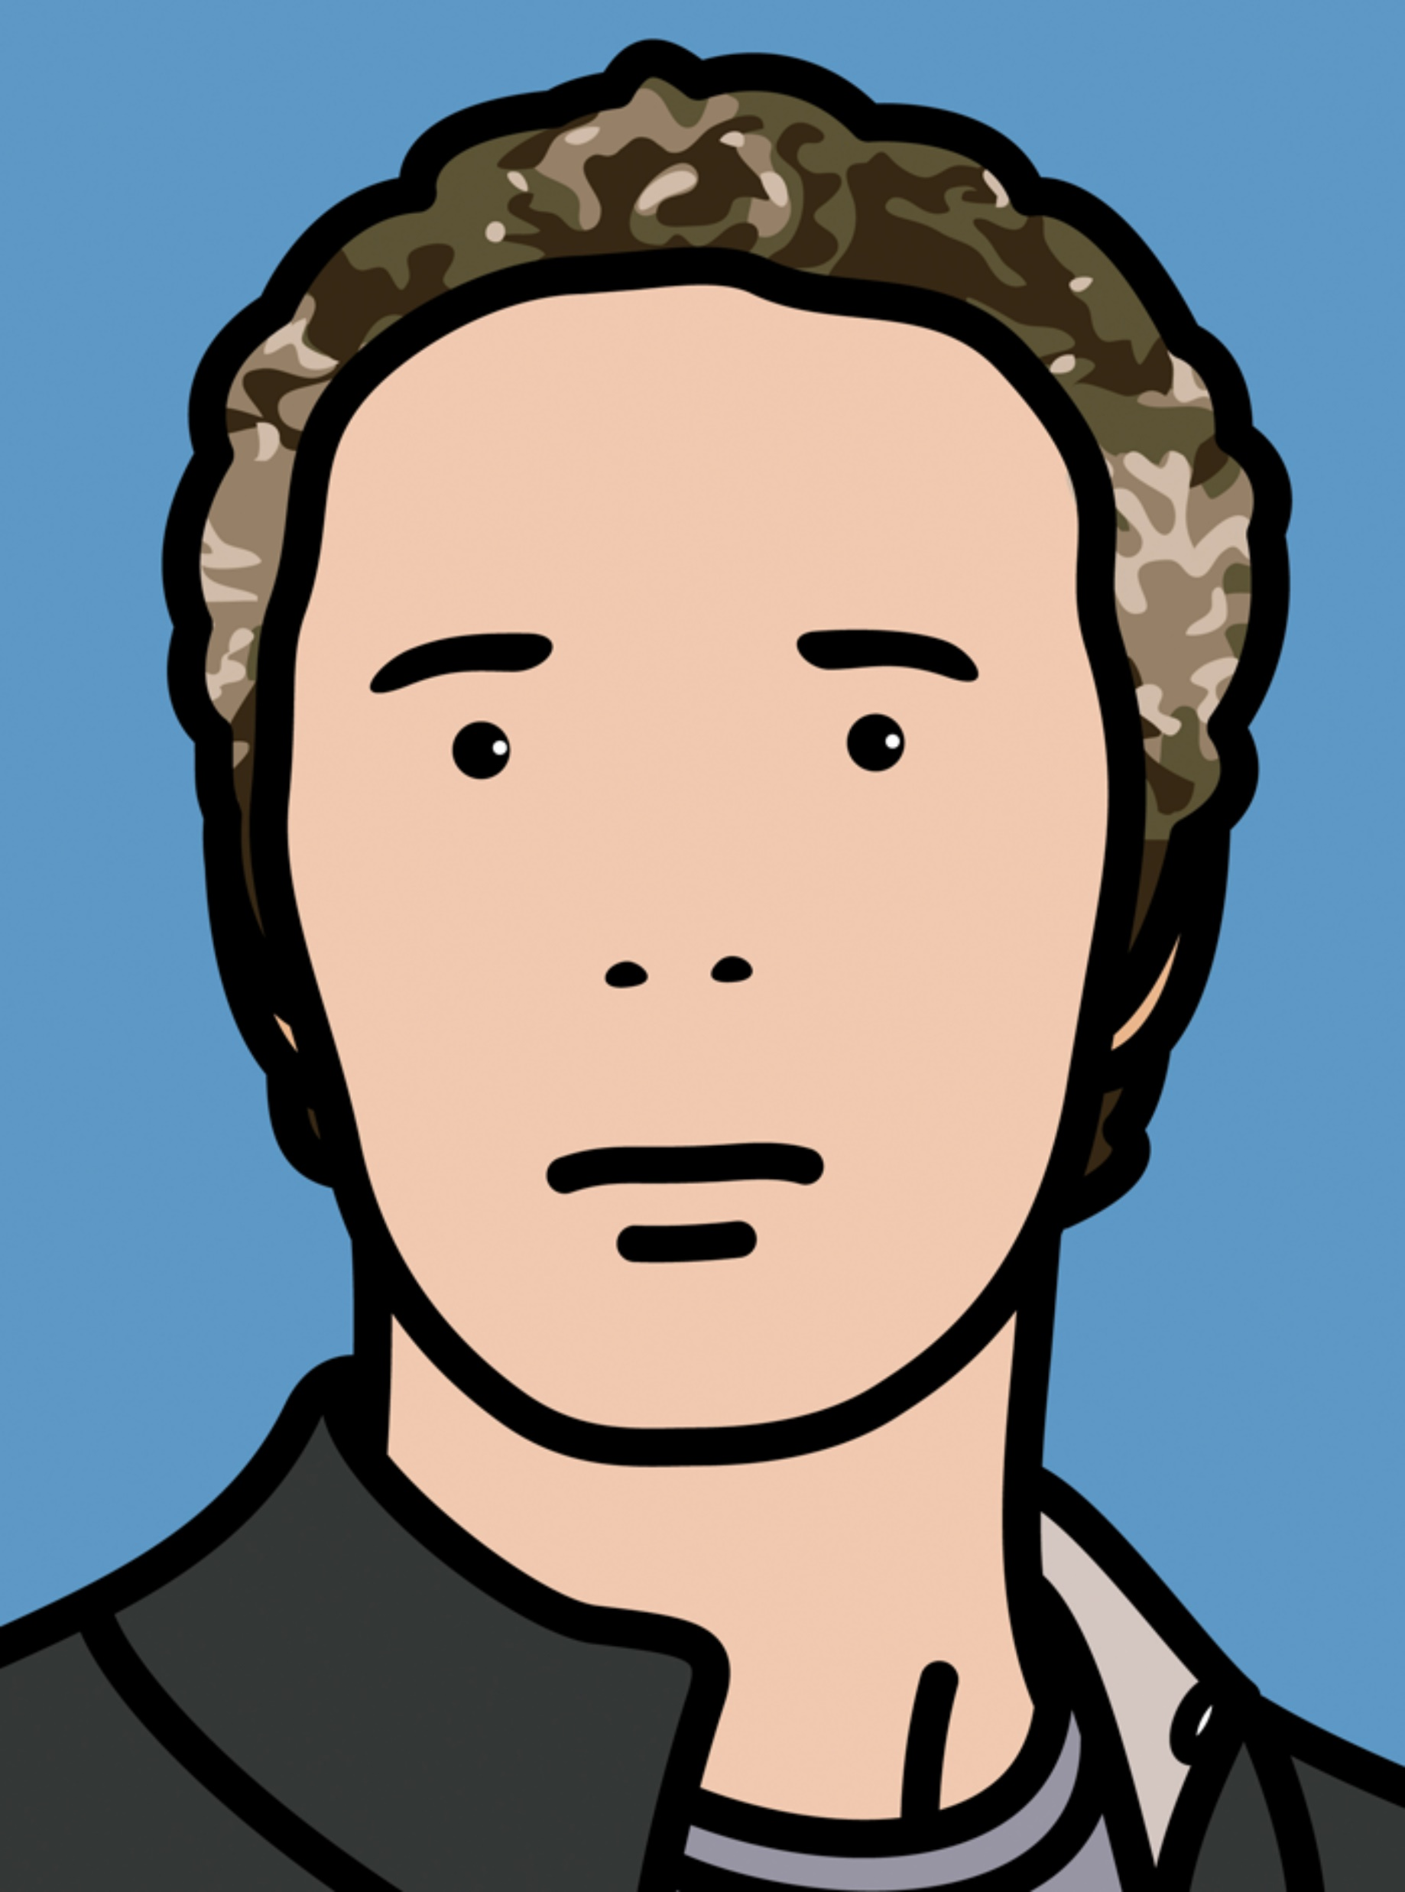
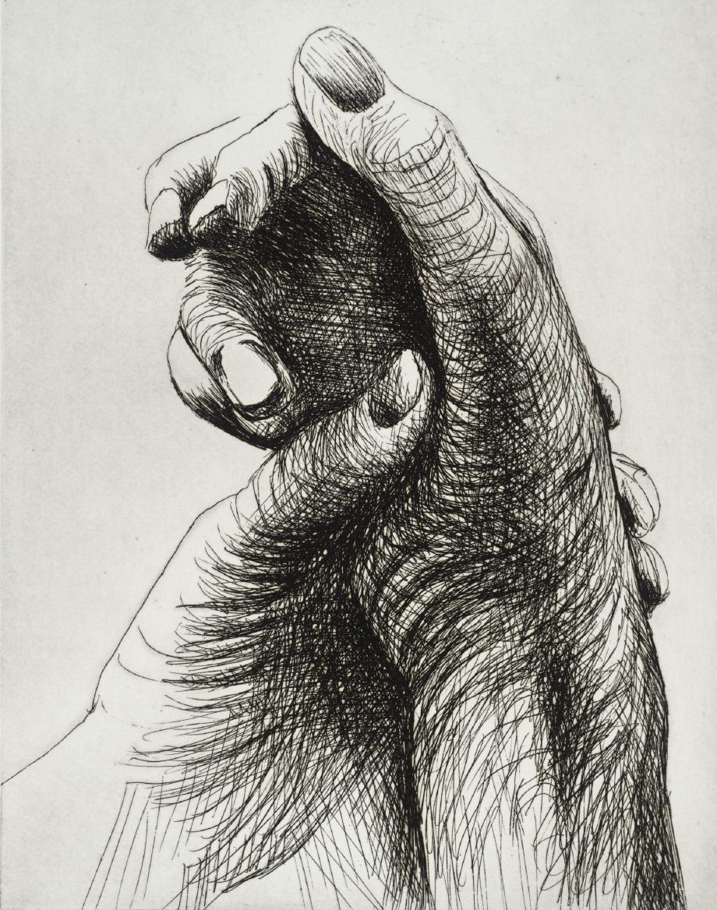
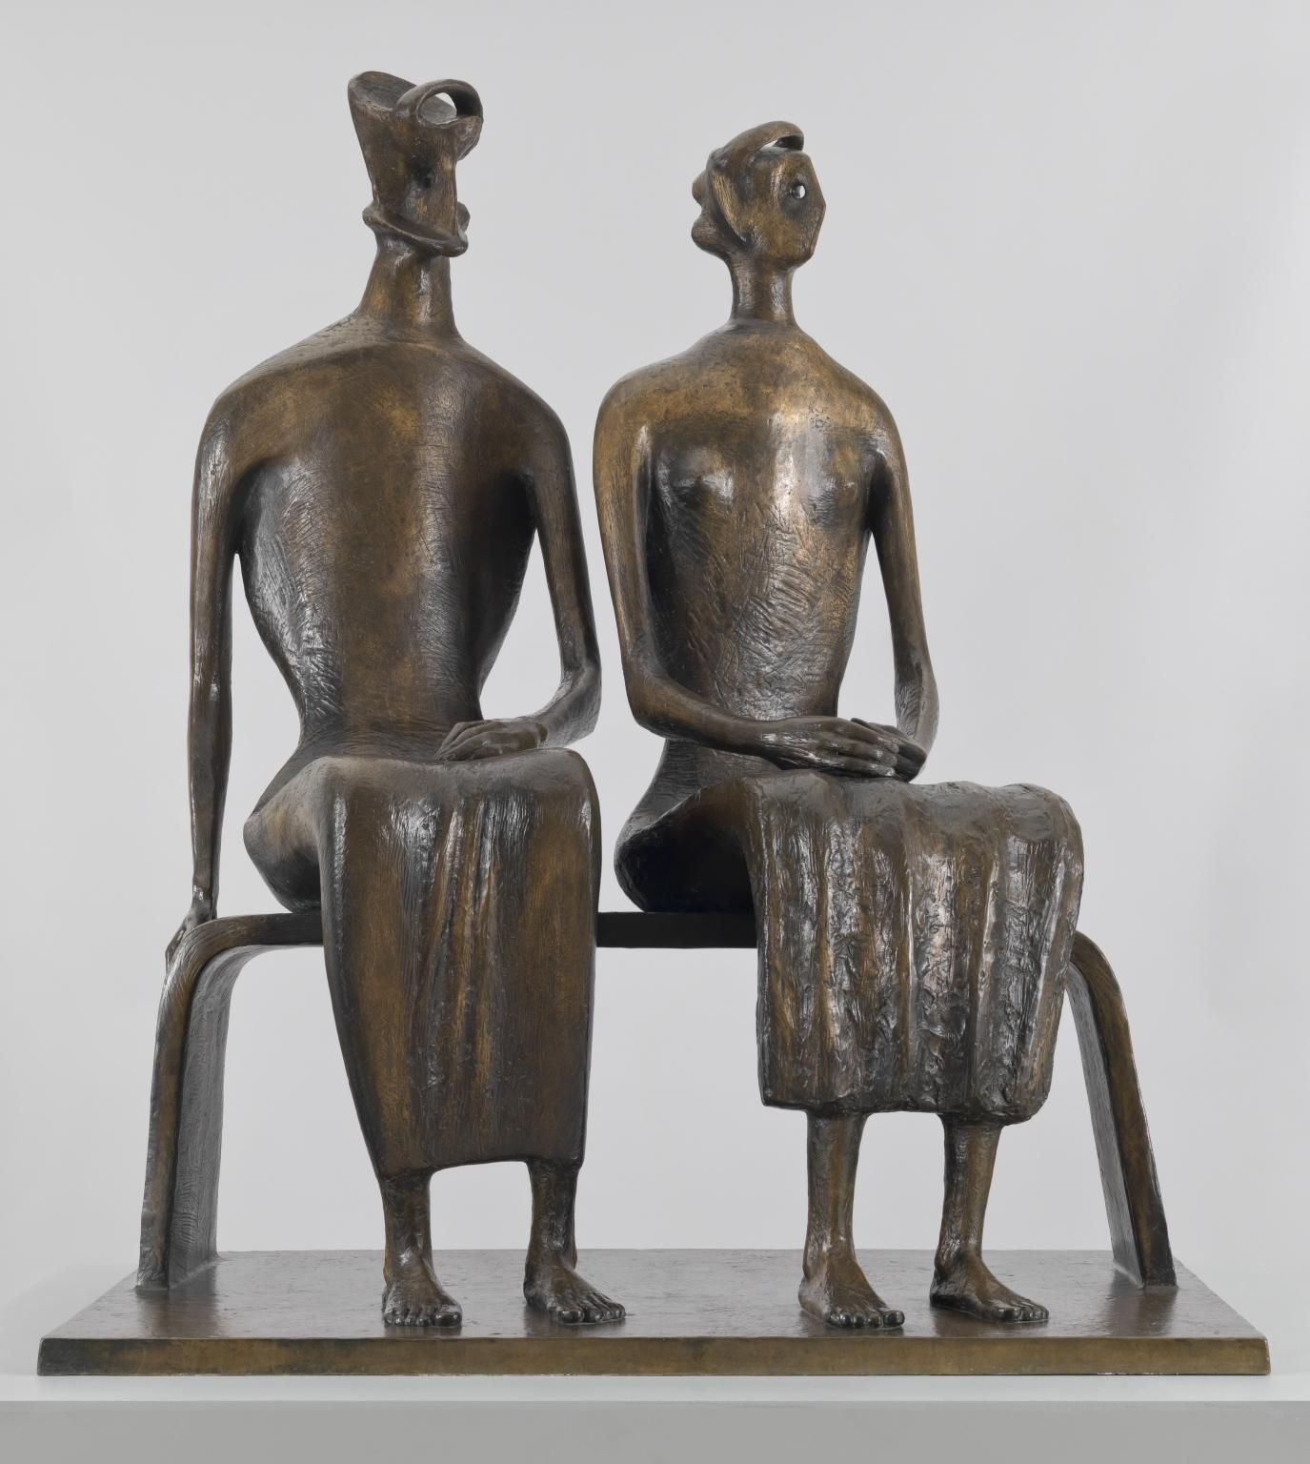
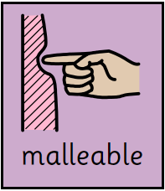
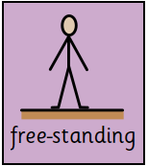
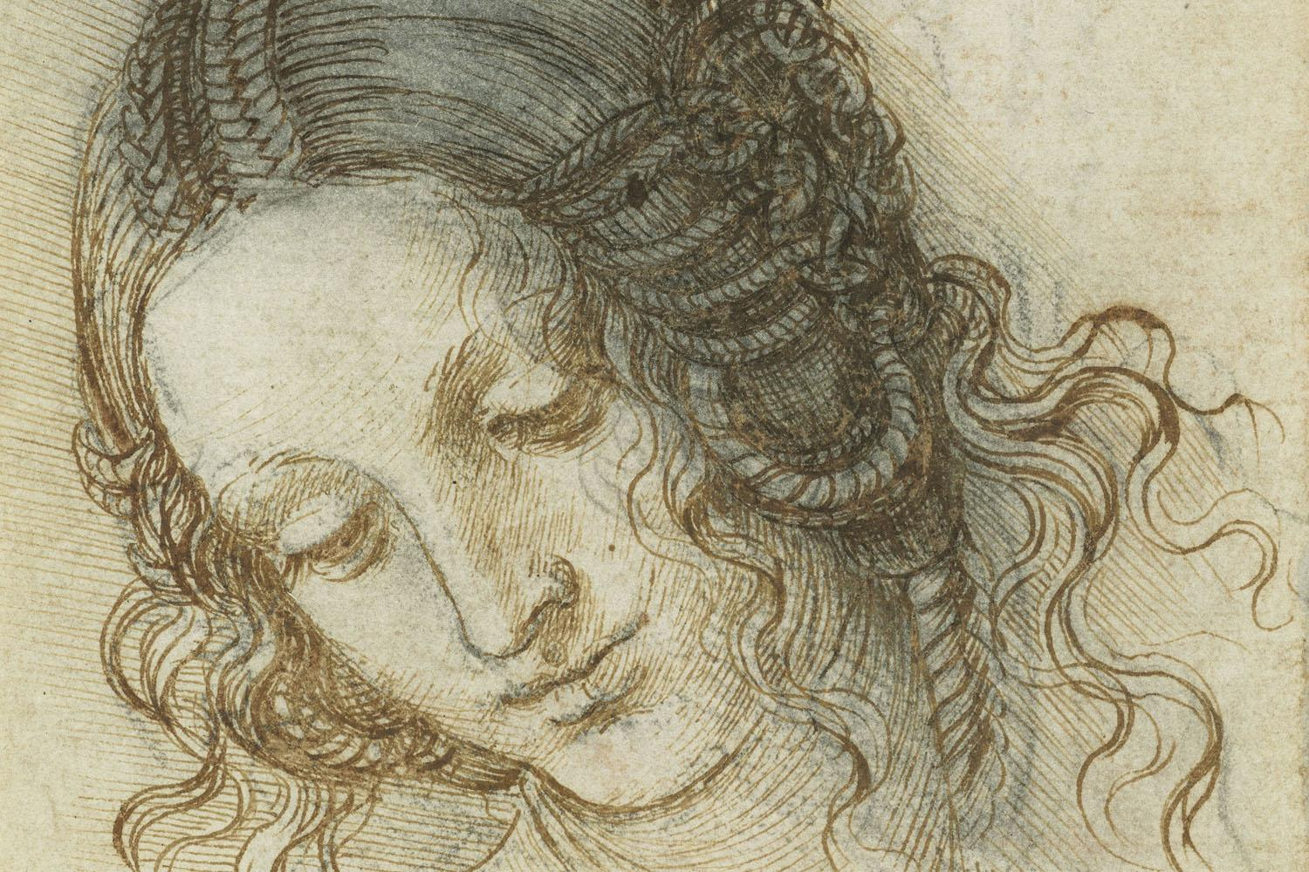
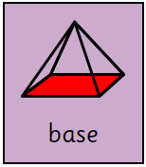
Year 1 - Term 1 – Me, Myself and I
Art Technique: Drawing and Sculpture
Brief: How does art show what the human body is like?
Key Vocabulary
A long mark.
Can be straight or curved.
I will know:
That different objects can produce lines of varying thickness
How to draw lines and shapes using different surfaces
How different media / materials create different marks e.g. pastels, chalk, felt tips, rubbers, charcoal, ballpoints
How to use a viewfinder to focus on a specific part of an object before drawing it
What a sculpture is
A free-standing sculpture needs a solid or flat base in order to stand
That clay is a malleable natural material
That water makes clay softer and easier to mould but that too much can make it unworkable. That clay can crack when it dries if it is too thin
How to use a variety of techniques e.g. rolling, cutting, bending, coiling, kneading, joining, folding and pinching
How to create different kinds of shapes with modelling materials
The outline of something such as a triangle, square or circle.
A 3D object representing something.
Key Artists and Art Works
A material that can be moulded when wet.
Julian Opie
Henry Moore
Can change its shape (moulded) without breaking or cracking.
Stands up on its own without support.
Leonardo Da Vinci
The lowest part, or bottom of something, on which everything else rests.

