Slide 1

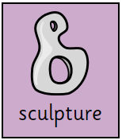
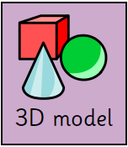
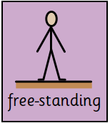
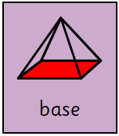
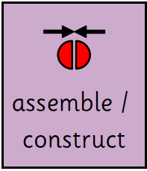
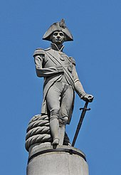
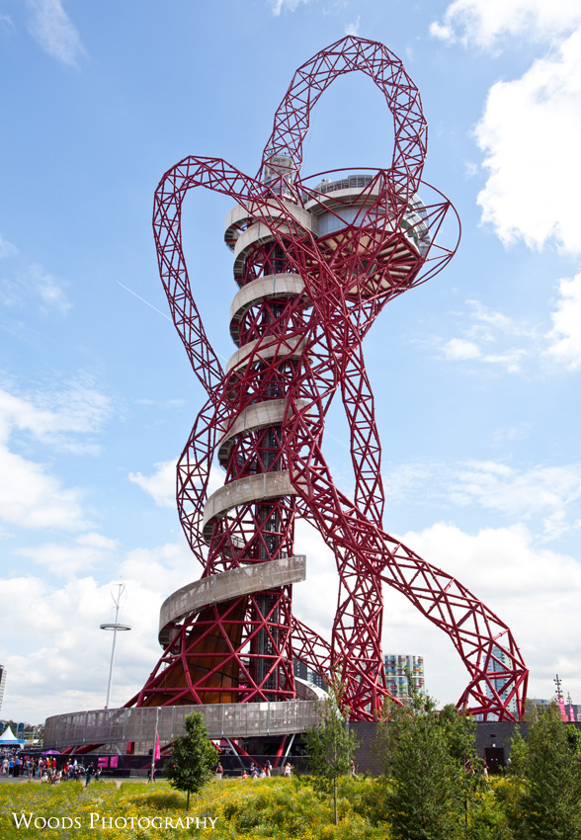
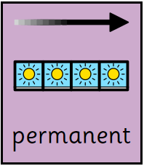
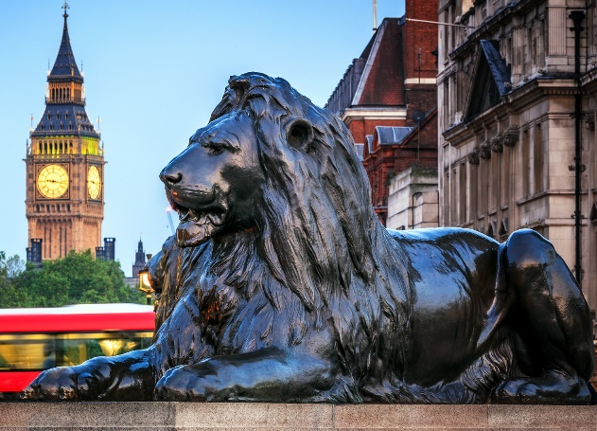
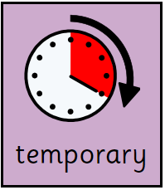
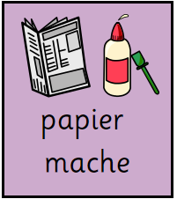
Year 2 - Term 1 – The Big Smoke (London/UK)
Art Technique: Sculpture
Brief: Celebrating Britain – how do sculpture and architecture celebrate Britain?
Key Vocabulary
A 3D object representing something.
I will know:
What a sculpture is
Sculptures can be made from natural or man-made materials and have different associated properties
Sculptures can be permanent or temporary
A free-standing sculpture needs a solid or flat base in order to stand
How to assemble and construct a sculpture using natural, recycled and manufactured materials e.g. clay, straw, card, newspaper
How to use papier mâché to create simple 3D effects
Three-dimensional object with a length, width and height.
Stands up on its own without support.
The lowest part, or bottom of something, on which everything else rests.
Key Artists and Art Works
Edwin Landseer – Trafalgar Square Lions
Edward Hodges Baily – Nelson’s Column
Anish Kapoor – AncelorMittal Orbit
Put parts together.
Lasting for a long time or intended to last forever.
Lasts for a certain amount of time. Not permanent.
A mixture of paper, glue and water that become hard when it is dry.

