Slide 1
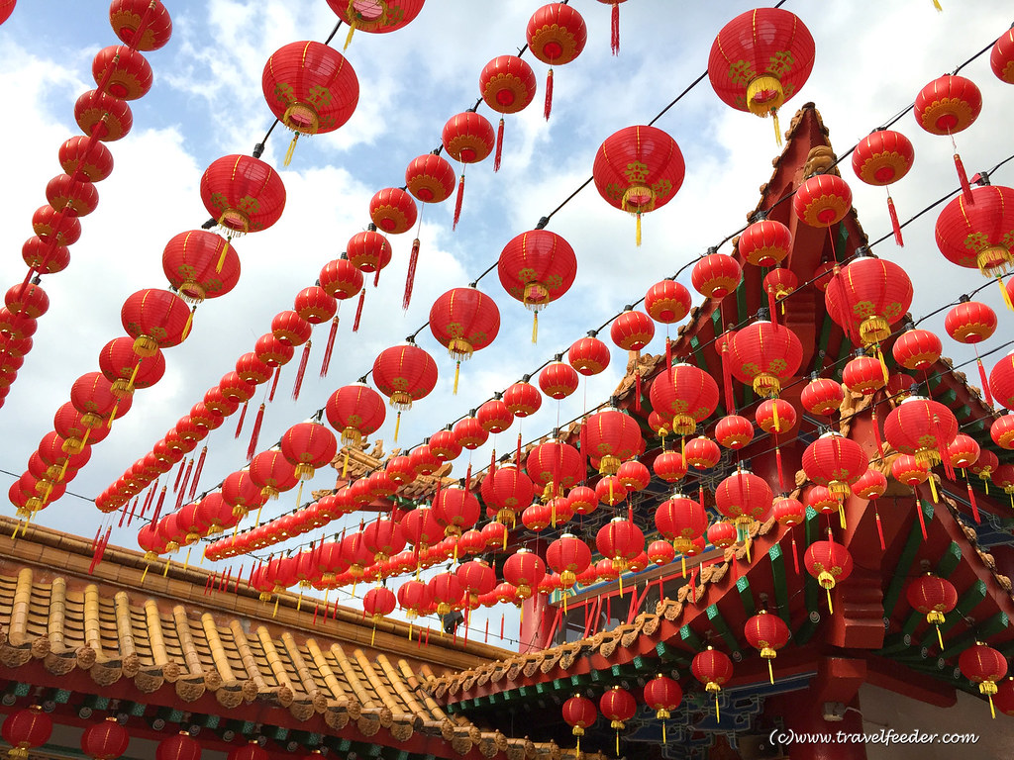

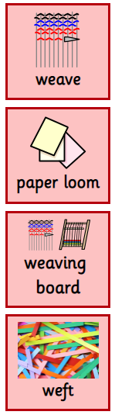
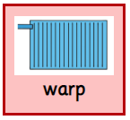
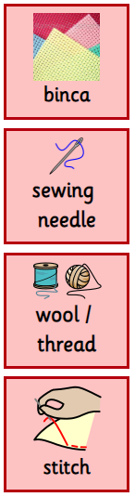
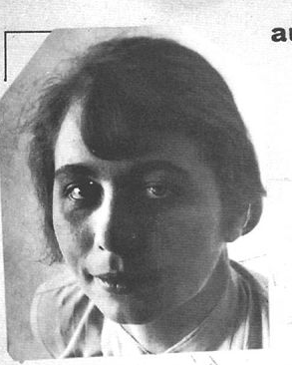
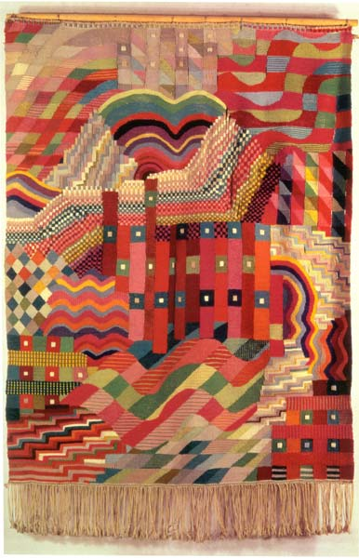
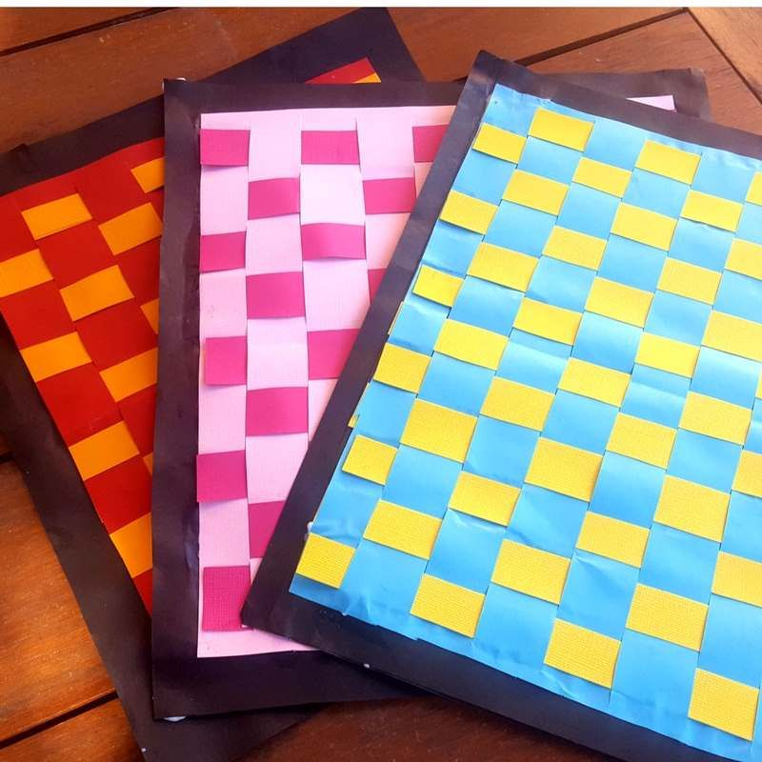
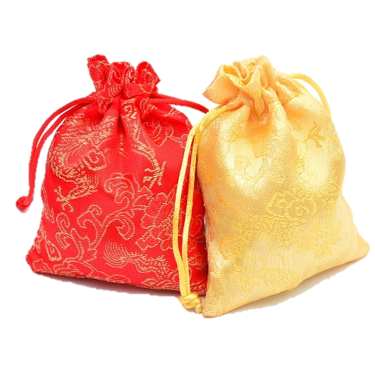
Year 2 - Term 3 – China
Art Technique: Paper weaving / Sewing
Brief: Chinese New Year – A celebration of Chinese culture.
Key Vocabulary
Interlacing long threads passing in one direction.
I will know:
To know what weaving is.
To know how weaving has been used in the past or to create pieces.
To know how to decorate textiles with glue (e.g. beads, buttons, feathers) or simple stitching (e.g. adding shapes using running stitch), to add colour and detail.
To know how to sort threads and fabrics by colour and texture ready for weaving.
To know that a weave can incorporate fabric and thread as well as natural materials e.g. grass and twigs.
A frame for weaving paper threads.
A tool to support the weaving process.
Paper threads weaved across the ‘warp’.
Paper threads running lengthwise on the loom.
Key Artists and Art Works
A firm fabric/canvas with large holes used for sewing.
A tool used for hand-sewing with a pointed tip and a hole (eye) to hold the thread.
Paper weaving
Gunta Stölzl
A ling, thin strand of material used for sewing.
A piece of thread sewn into material using a single movement.
Chinese Money Purse

