Slide 1

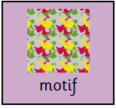
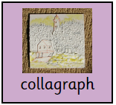
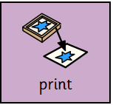
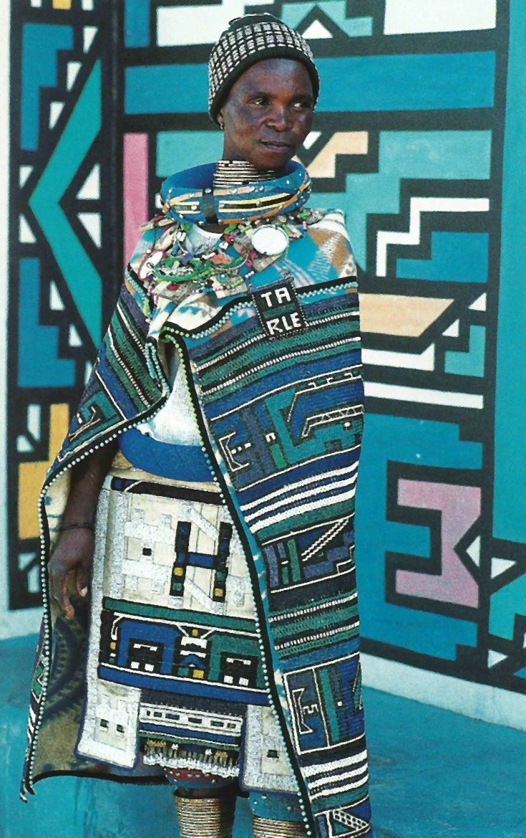
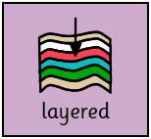
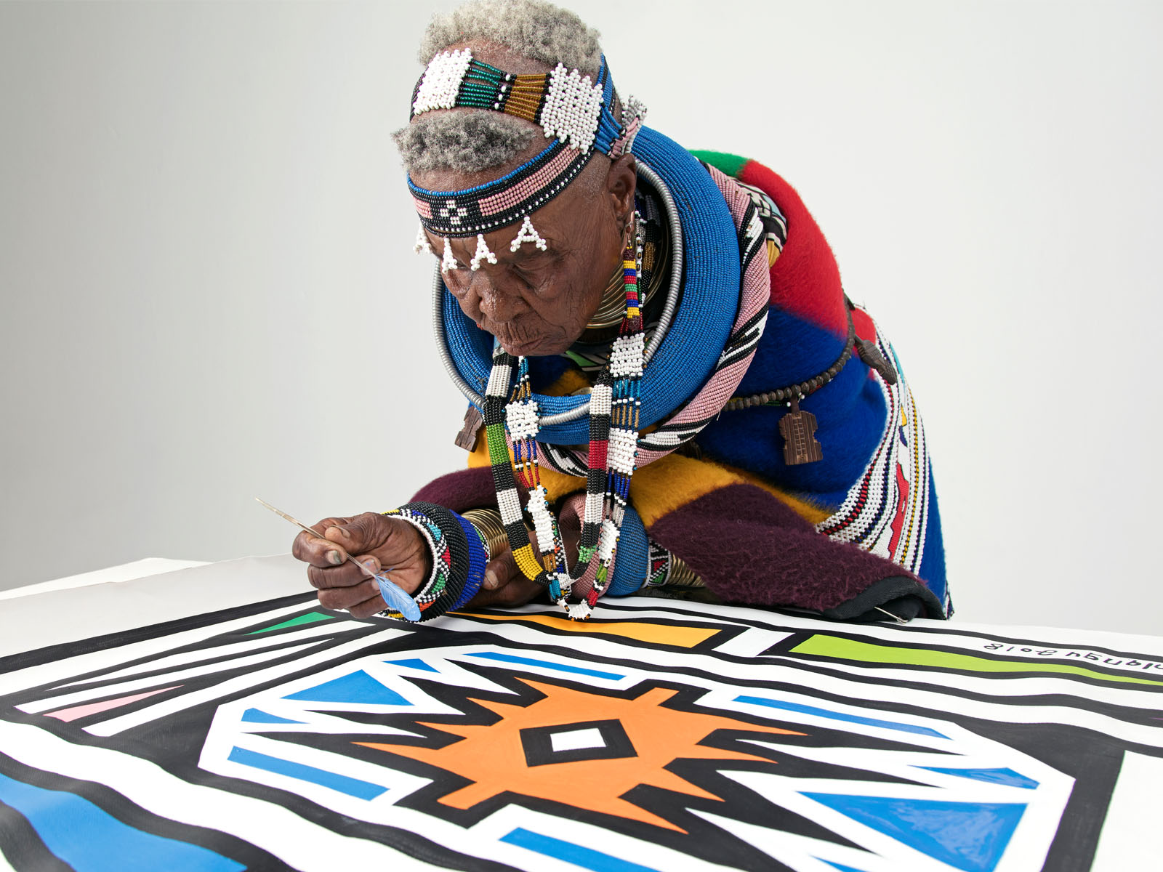
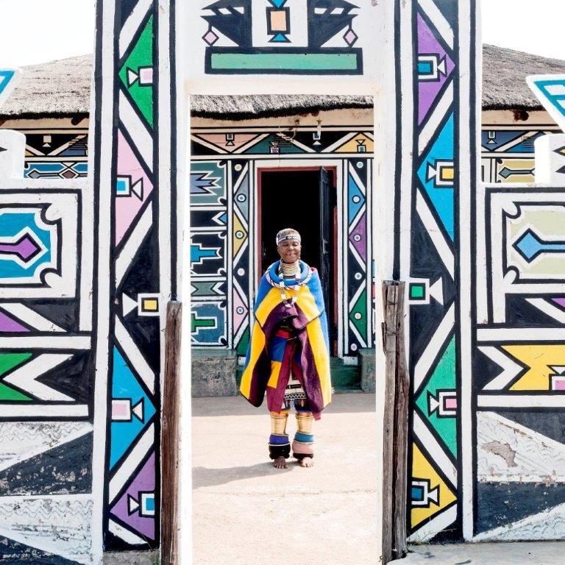
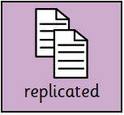
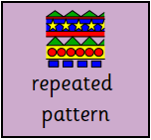
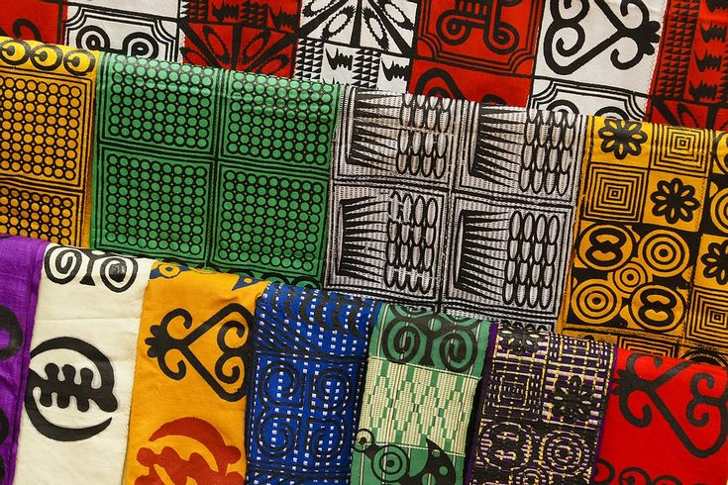
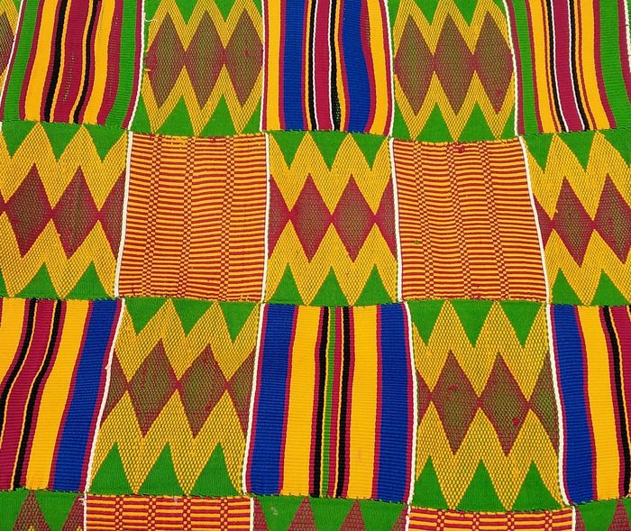
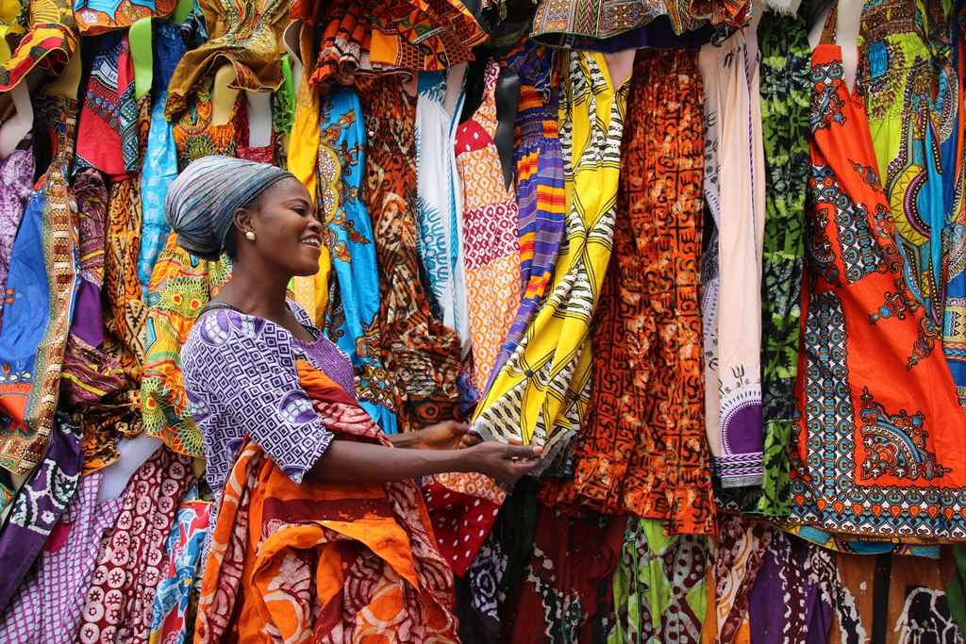
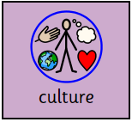
Year 4 - Term 1 – Jambo (Africa)
Art Technique: Design and Printing
Brief: Symbolism – can we create our own symbol?
Key Vocabulary
A repeated image or design, forming a pattern
I will know:
That colours can be layered in a print
That patterns can be repeated and replicated
How motifs use repeated patterns
That shapes in a pattern can be regular and irregular
That printing blocks can be made in different ways
What collagraph is and use it to create a print
A technique for printing by collaging materials to a base, painting and pressing onto a surface.
Making a picture from a prepared surface.
Key Artists and Art Works
Esther Mahlangu
Pieces arrange in layers with some above/below other pieces.
Ndebele Women
Make an exact copy.
A shape or image that is replicated many times in a predictable order.
Adinkra Cloth
Ashanti Tribe
African Wax Prints
The ideas, customs and way of life of a group of people.

