Slide 1

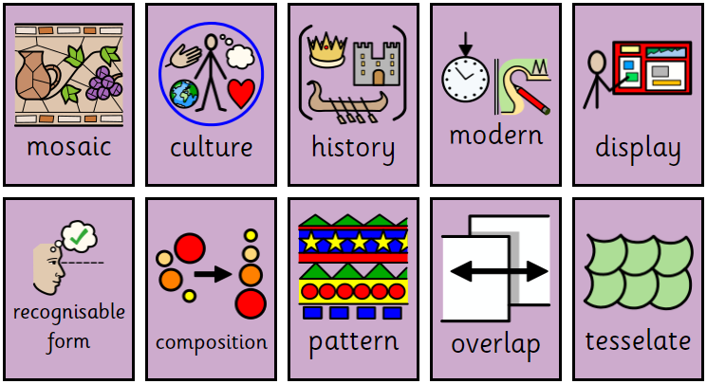
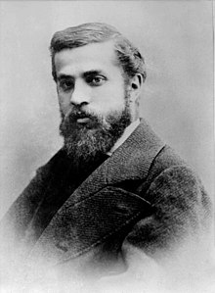
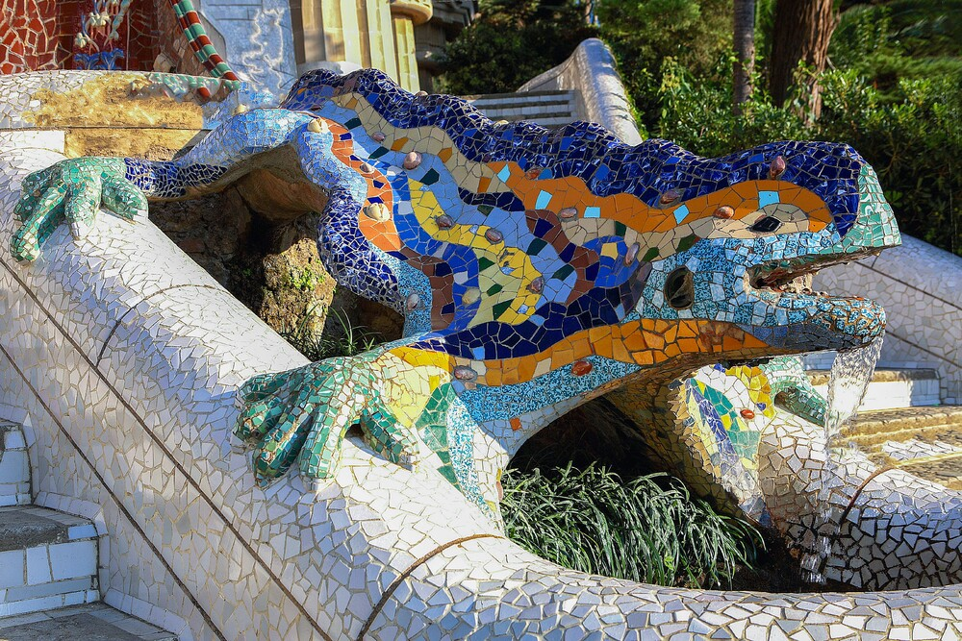
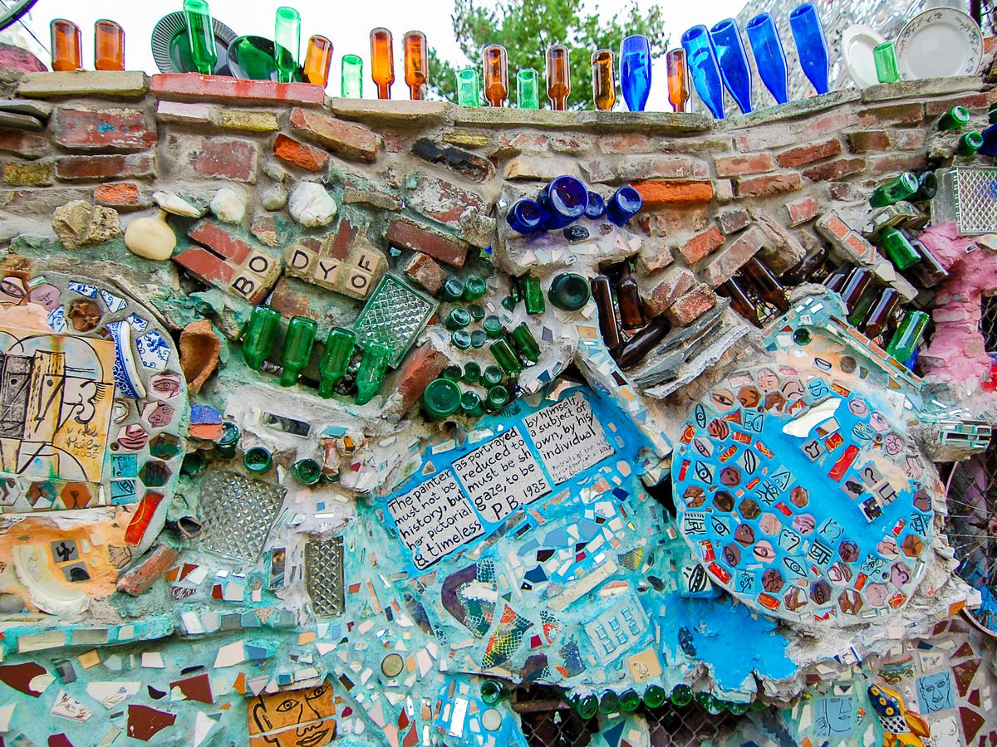
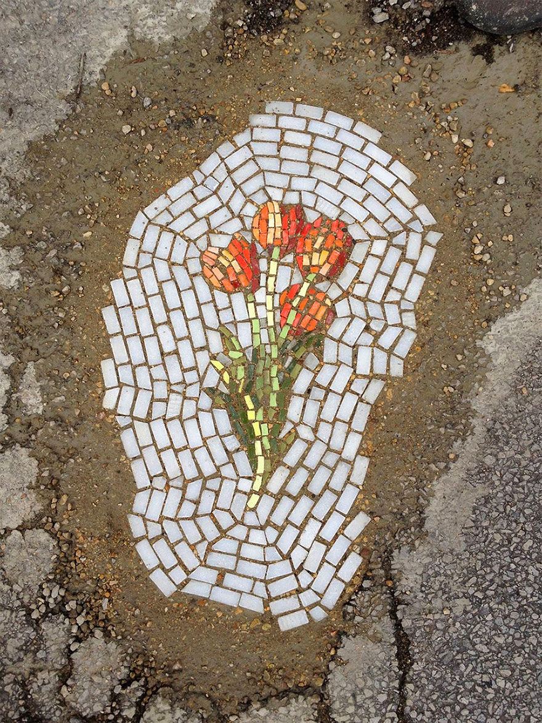
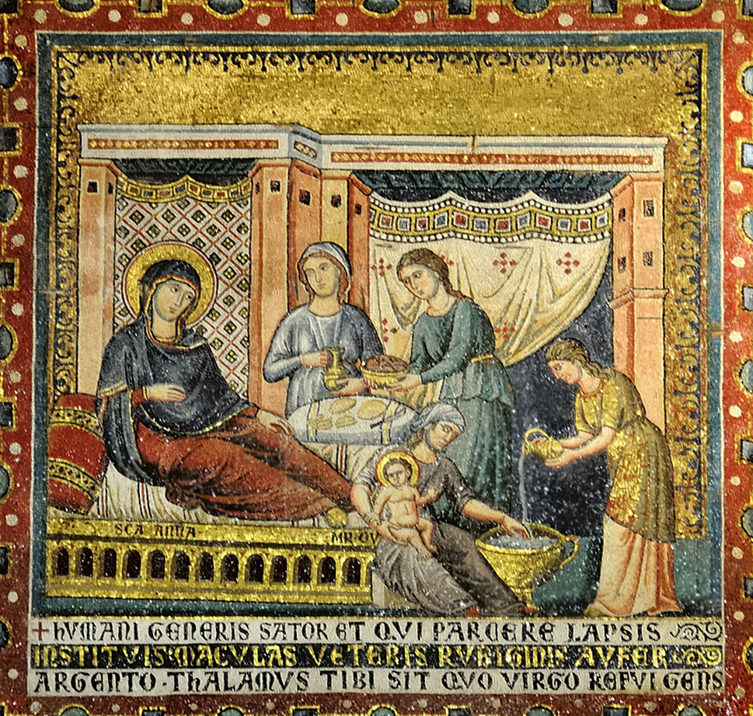
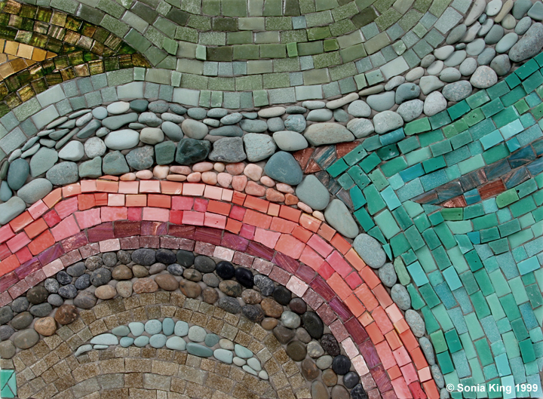
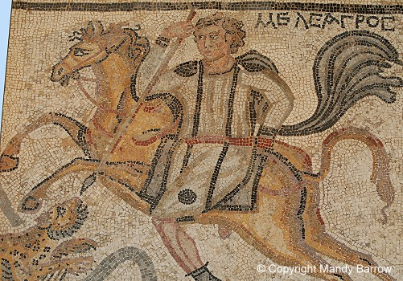
Year 4 - Term 3 – Rotten Romans
Art Technique: Collage (mosaic)
Brief: Enhancing Places and Spaces – how can we use mosaic to enhance areas around our school / local area?
Key Vocabulary
Decorating a surface with designs using small pieces of material
I will know:
What a mosaic is
Where mosaics have been used in the past and in different cultures
How a mosaic is created to show a recognisable form or pattern
Know that materials can be overlapped in a mosaic
Know that mosaics can show pattern and tessellation
The ideas and customs of a group of people
A shape or design that is easy to recognise
Key Artists and Art Works
How pieces are combined or arranged
Antonio Gaudi
Isaiah Zagar
A design in which lines, shapes, forms or colours are repeated
Jim Bachor
Pietro Cavallini
Sonia King
Roman Mosaic
Pieces that extend past and cover another part, or go in front of it
A pattern of repeated shapes that fit together closely, without gaps or overlapping

