Slide 1

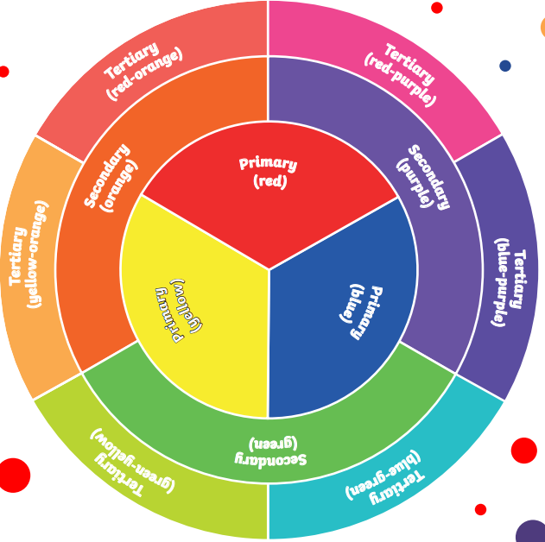
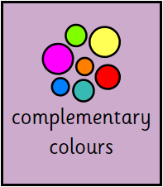
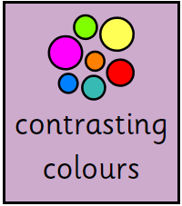
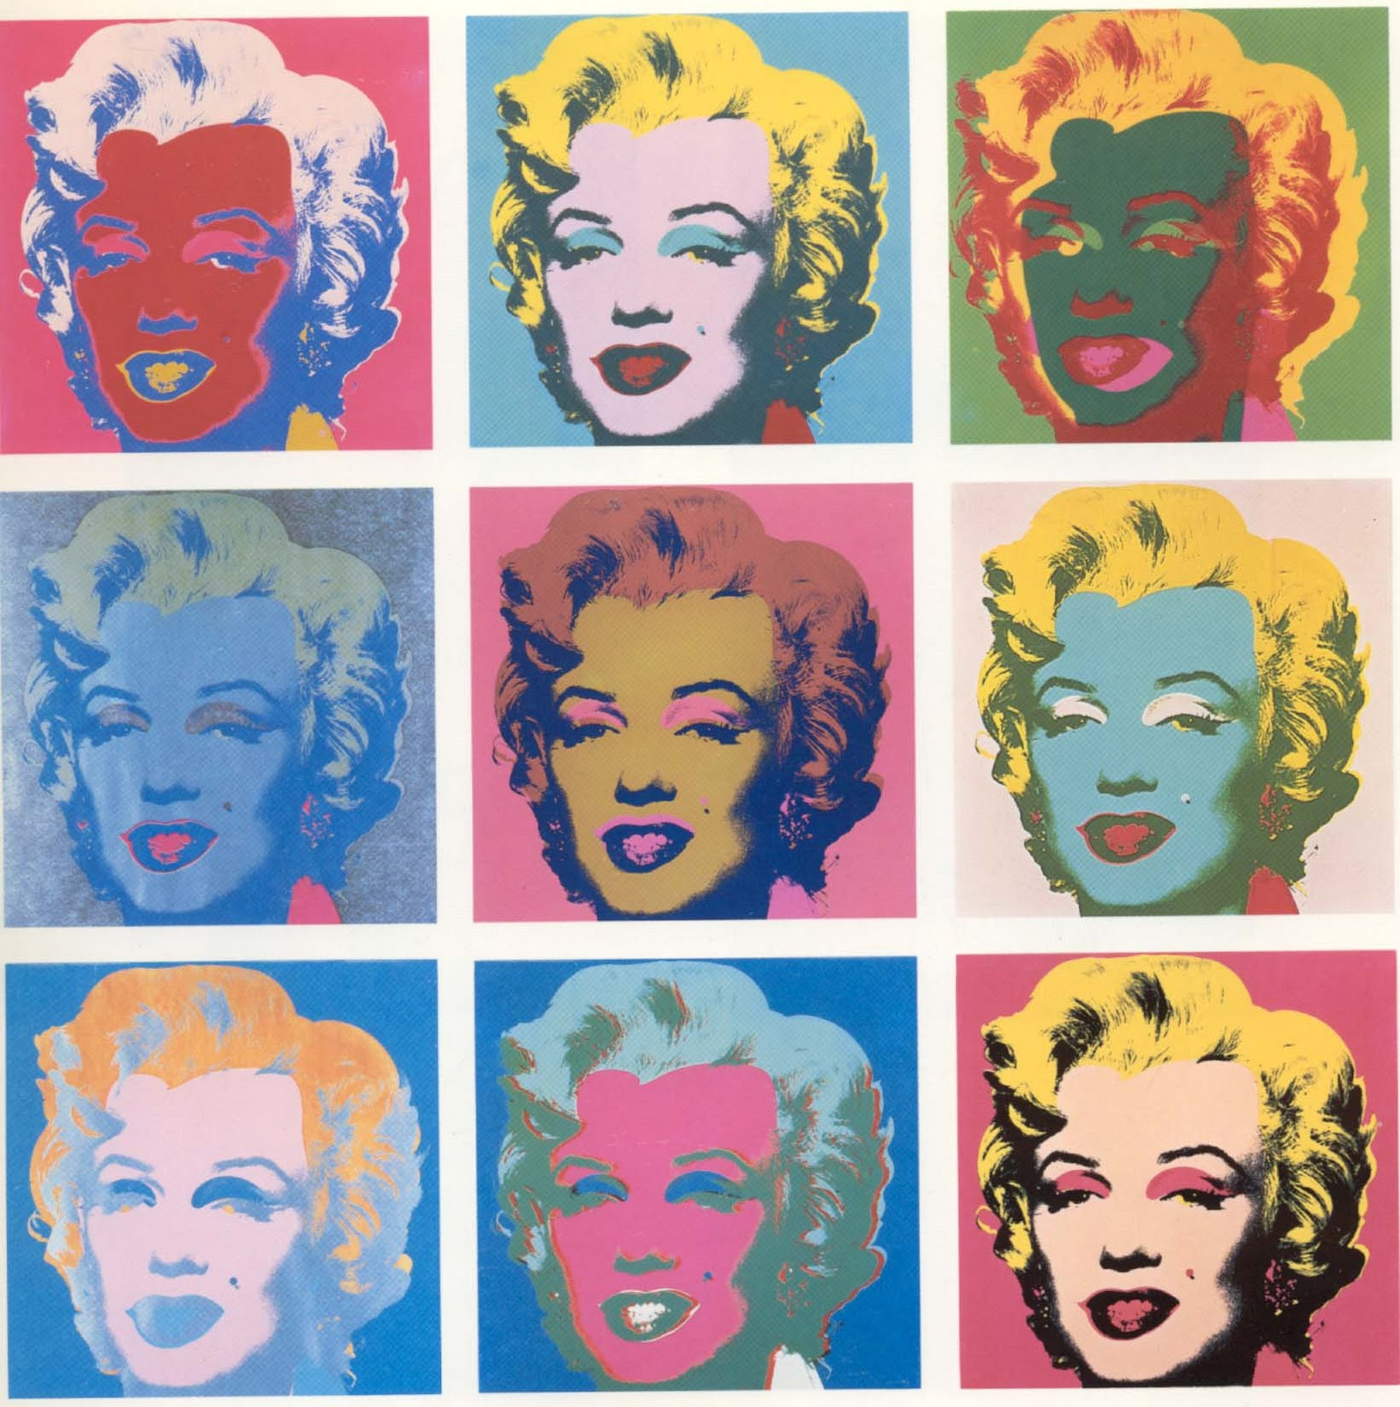
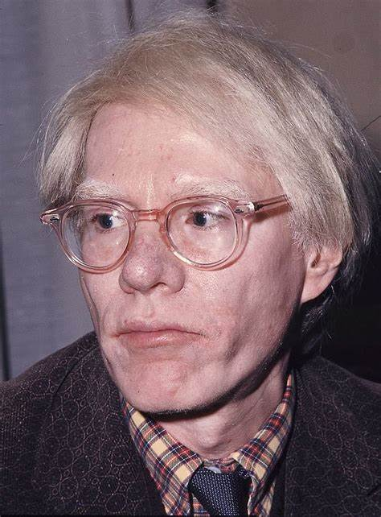
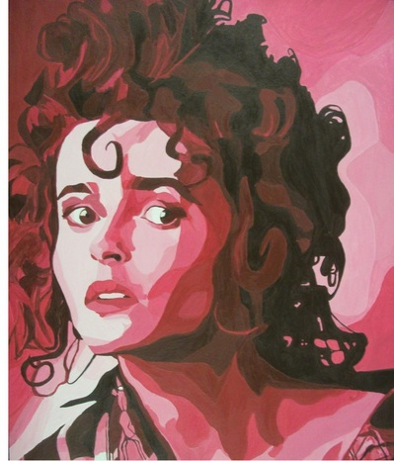

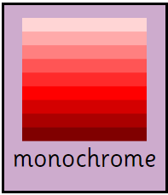
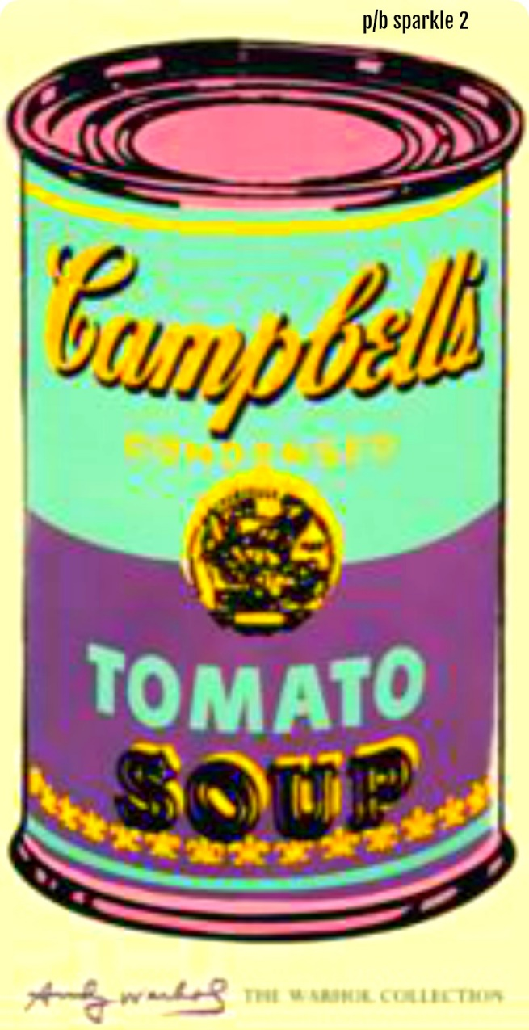
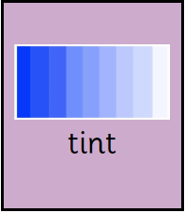
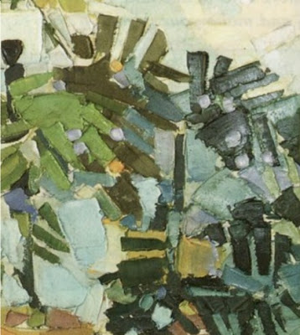
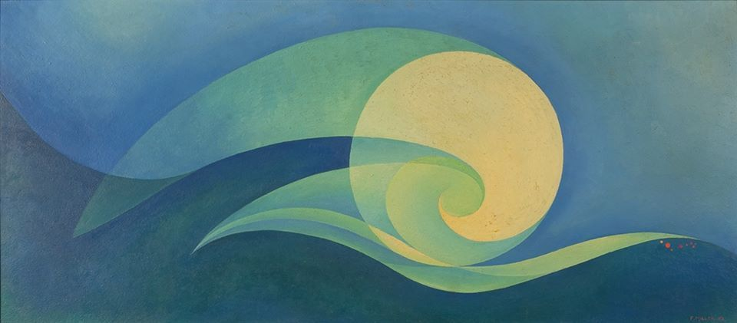
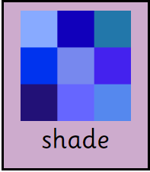
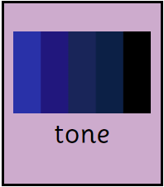
Year 5 - Term 1 – Let’s Explore America!
Art Technique: Painting
Brief: Life in full colour – how is colour used in art?
I will know:
How to use and apply a range of paint, paint tools and techniques
How to mix and match colours to create atmosphere and light effects
How to create a background using a wash
How to identify, mix and use primary, secondary, complementary and contrasting colours, monochrome
How different paints can produce different tints, tones and shades e.g. compare watercolour and acrylic
Key Vocabulary
Andy Warhol
Key Artists and Art Works
Colours that are opposite on the colour wheel.
Mark Rothko
An image using varying tones of only one colour.
Lightening a colour by adding white.
Jessica Hoffman
Florence Miller Pierce
Darkening a colour by adding black.
The lightness of darkness of a colour.
Ad Reinhardt

