Slide 1

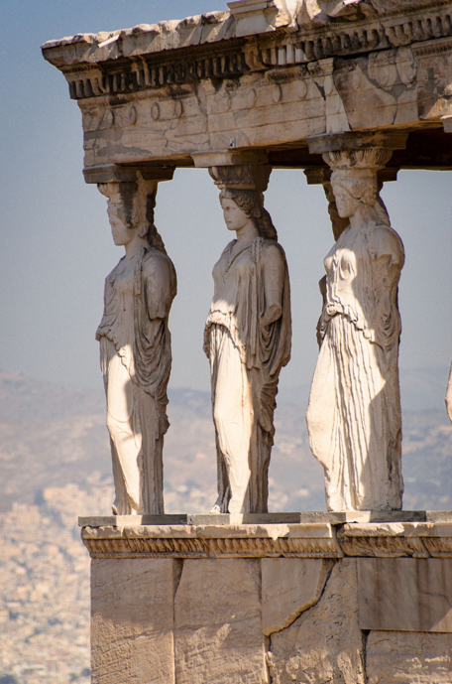
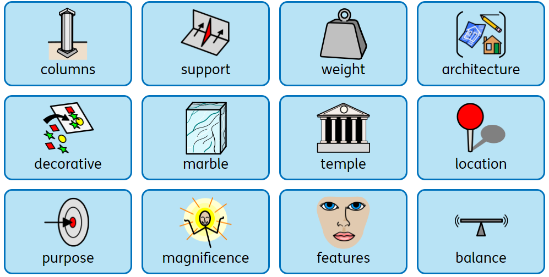
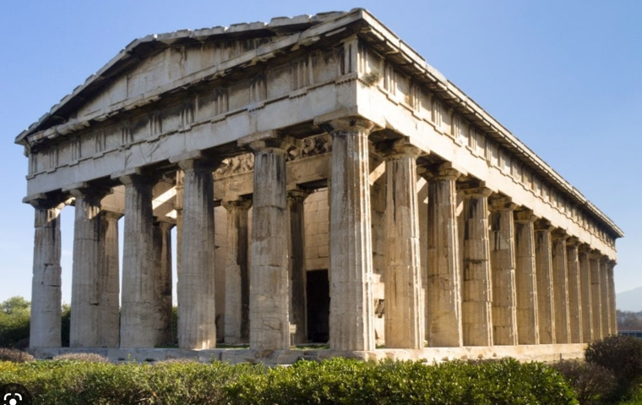
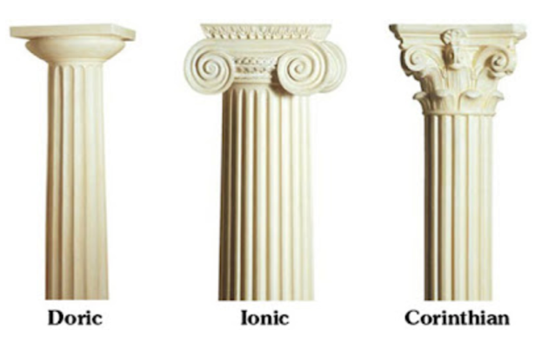
Knowledge Organiser
D.T. – Term 2
Greek Architecture –
Greek temples and columns
What I should already know:
some buildings that were built a long time ago still survive today
What I will learn
I will:
know the Greeks were well-known for their architecture
know the importance of columns
know the different types of columns
know how to design a structure with columns
know how to make a model
know how to evaluate a structure that has been constructed
Key vocabulary

