Slide 1

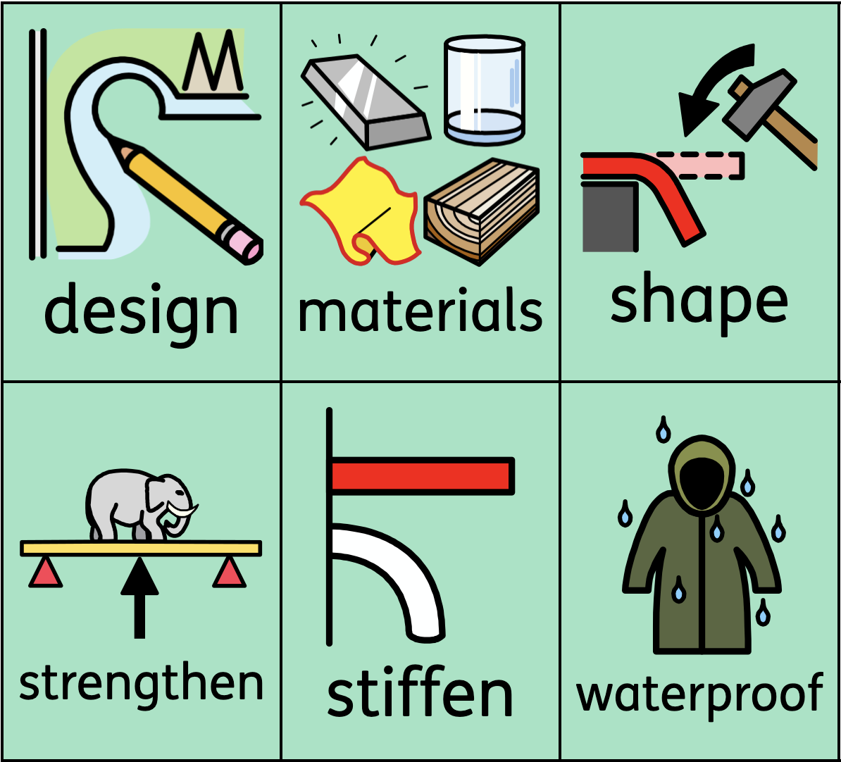
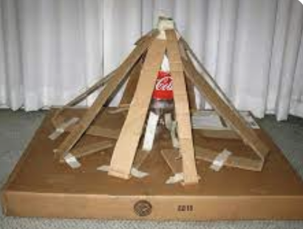
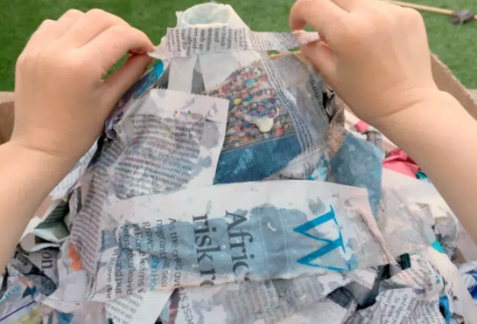
Knowledge Organiser
D.T. – Term 4
Erupting volcano model
What I should already know:
How to make a model from cardboard
What an erupting volcano looks like
What I will learn
I will:
know different ways to create a structure
know how to design and select suitable materials
Know how to strengthen and stiffen a structure
know how to use papier-mache to build a model
know how to evaluate a model
Key vocabulary

