Slide 1


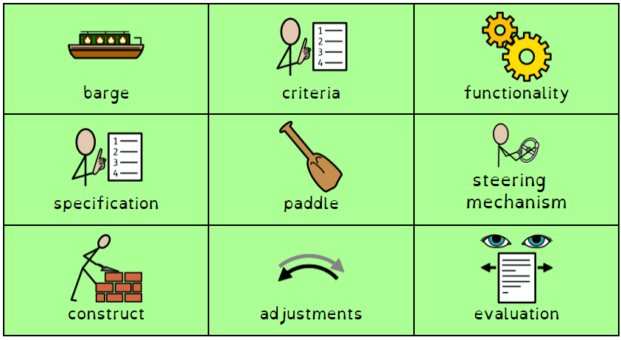
Beer and Barges
Boat building
DT Year 4 Term 6
What should I already know?
What am I going to learn? (Sticky t am I going to learn? (Sticky am I going to learn? (w
What should I already know?
To be able to understand what a product is and who it is for.
To be able to identify the materials used to make a product
To be able to design purposeful, functional and appealing products for themselves and other users based on design criteria.
To be able to select from and use a wide range of materials and components, including construction materials, textiles and ingredients, according to their characteristics.
To evaluate their own ideas and products against design criteria.
What am I going to learn? (Sticky knowledge)
To know the features and purpose of a barge boat
To investigate materials and their functionality regarding boat building
To design and plan for building a barge boat model based on a criteria
To construct a barge boat model based on a plan and design using a number of materials and appropriate techniques
To test barge boat models against the chosen criteria
To evaluate the process of research, design and making for barge boat building and consider next steps to improve further.
Vocabulary

