Slide 1


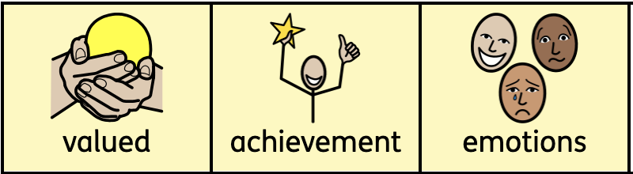
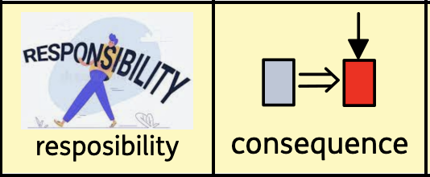
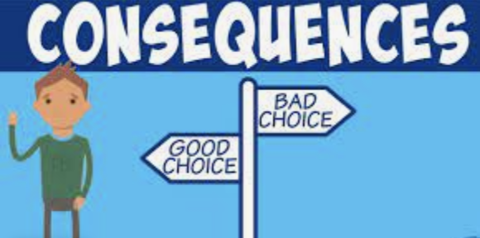
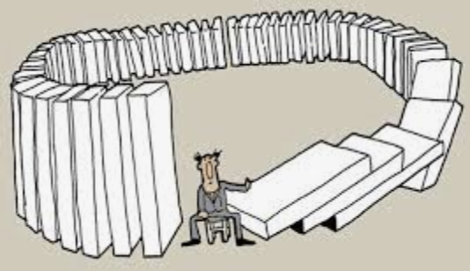
Knowledge Organiser
PSHE– Term 3
Bring Me in My World
What I should already know:
the rights and responsibilities for being a member of my class
the rights and responsibilities for being a member of my class and school
how to listen to other people and contribute my own ideas about rewards and consequences
how to recognise the choices I make and understand the consequences
What I will learn
I will:
know how to recognise my worth and identify positive things about myself and my achievements
know how to face new challenges, make responsible choices and ask for help if needed
know why rules are needed and how they relate to rights and responsibilities
know that my actions affect myself and others and care about other people’s feeling
know how to make responsible choices and take action
know that my actions affect others and try to see things from their points of view
Key vocabulary

