Slide 1

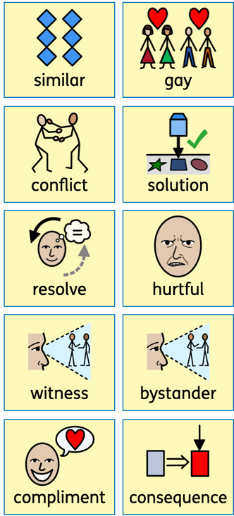
Knowledge Organiser
PSHE– Term 2
Celebrating Difference
What I should already know:
some people make assumptions about people because they are different e.g. boys and girls
some of the ways I am different to others
that it is OK to be different to others
that bullying is sometimes about difference
What I will learn
I will:
understand that everybody’s family is different and important to them
understand that differences and conflicts sometimes happen among family members
know what it means to be a witness to bullying
know that witnesses can make the situation better or worse by what they do
recognise that some words are used in hurtful ways
know how to explain about a time when my words affected someone’s feeling and the consequences
Key vocabulary

