Slide 1

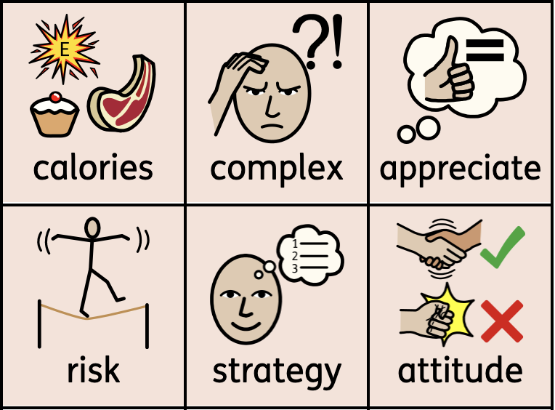
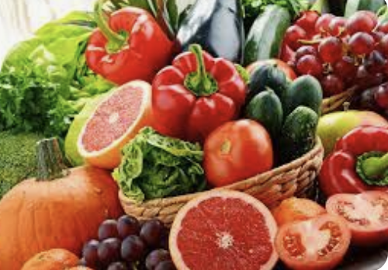
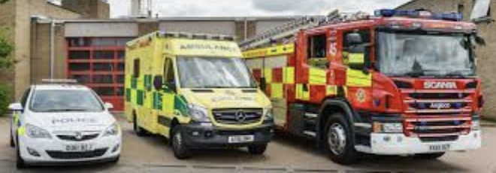
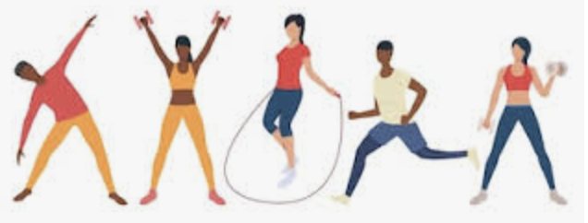
Knowledge Organiser
PSHE– Term 4
Healthy Me
What I should already know:
which foods are healthy
which foods are sugary
which foods are fatty
What I will learn
I will:
know how exercise affects my body and why my heart and lungs
know the amount of calories, fat and sugar I put into my body will affect my health
know how to explain my attitude towards drugs
identify things, people and places that I need to keep safe from and who can help me keep safe
know when someone feels safe or unsafe
know how complex my body is and how important it is to take care of it
Key vocabulary

