Slide 1


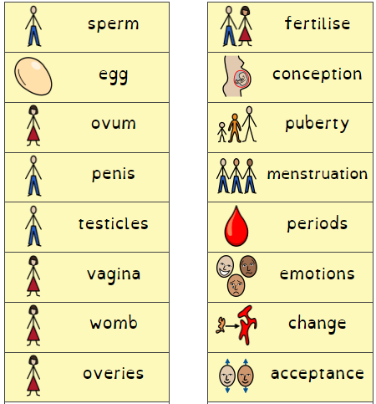
Jigsaw PSHE
Term 6 – Changing Me
Year 4
What should I already know?
What am I going to learn? (Sticky t am I going to learn? (Sticky am I going to learn? (w
What I should already know?
I understand that in animals and humans lots of changes happen between birth and growing up, and that usually it is the female who has the baby
I understand how babies grow and develop in the mother’s uterus
I understand that boys’ and girls’ bodies need to change so that when they grow up their bodies can make babies
I can identify how boys’ and girls’ bodies change on the inside during the growing up process and can tell you why these changes are necessary so that their bodies can make babies when they grow up
I can start to recognise stereotypical ideas I might have about parenting and family roles
Identify what I am looking forward to when I move to my next class
What am I going to learn? (Sticky knowledge)
Understand that some of my personal characteristics have come from my birth parents and that this happens because I am made from the joining of their egg and sperm
Correctly label the internal and external parts of male and female bodies that are necessary for making a baby
Describe how a girl’s body changes in order for her to be able to have babies when she is an adult, and that menstruation (having periods) is a natural part of this
Know how the circle of change works and can apply it to changes I want to make in my life
Identify changes that have been and may continue to be outside of my control that I learnt to accept
Identify what I am looking forward to when I move to a new class
Vocabulary

