Slide 1

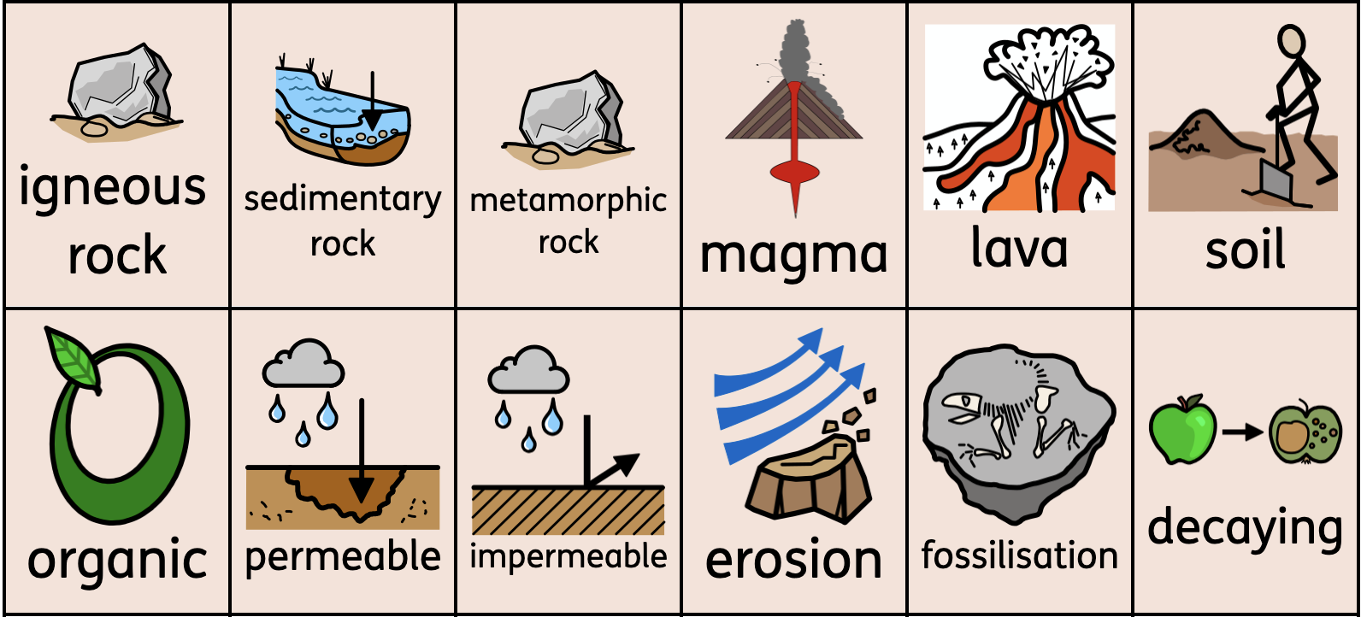
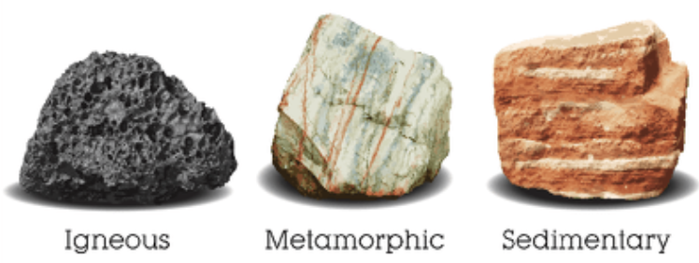
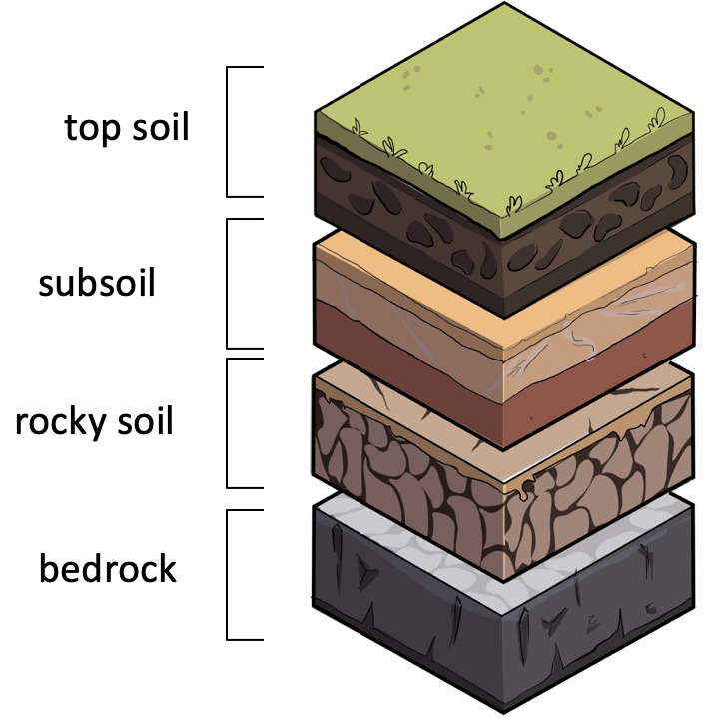
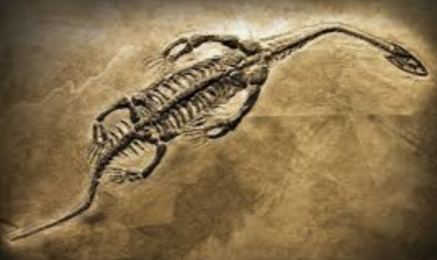
Knowledge Organiser
Science – Term 4
Rocks
What I will learn
I will:
know how rocks are different based on their appearance
know how rocks are different based in their physical properties
know that soils are made from rock and organic matter
investigate the permeability of soils
know that fossils are formed when living things are trapped in rock
Key vocabulary

