Slide 1



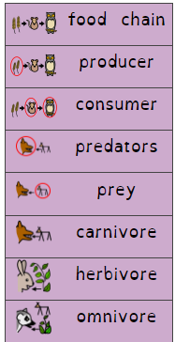
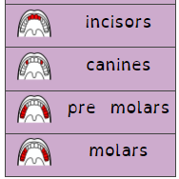
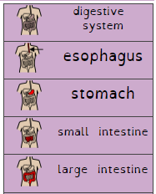
Science
Year 4 Term 6
Animals including humans
What should I already know?
What am I going to learn? (Sticky t am I going to learn? (Sticky am I going to learn? (w
What should I already know?
To know that animals, including humans, need the right types and amount of nutrition.
To understand animals, including humans, cannot make their own food, they get nutrition from what they eat.
To be able to classify vertebrate animals into groups: fish, amphibians, reptiles, birds and mammals
What am I going to learn? (Sticky knowledge)
To understand how to construct simple food chains.
To know how to interpret a variety of food chains.
To understand the terms producers, predators and prey
To know the simple functions of different types of teeth in humans.
To know that the teeth of carnivores and herbivores are different
To know the simple functions of the digestive systems in humans.
To know the main parts of the human digestive system.
Vocabulary

